Slide 1

Java Programming Essentials: A Comprehensive Journey into Core Java and Beyond
Bharath Ashok

Slide 2

Day 6

Slide 3
Day 6: Agenda
Static and final keywords
Exception Handling
Interview Questions
Hands-on
Assignments

Slide 4
static and final keywords

Slide 5
static keyword
static keyword in java:
The static keyword in Java is used to create class-level members that belong to the class itself, rather than to individual instances (objects) of the class.
Here's a breakdown of its usage:
static Variables (Class Variables): When a variable is declared as static, it is shared by all instances of the class. Only one copy of the static variable exists, regardless of how many objects are created. Static variables are accessed using the class name.
class MyClass {
static int count = 0; // Static variable
}
static Methods: A static method belongs to the class rather than an instance. It can be called using the class name without creating an object of the class. Static methods can only access static variables/methods.
class MathUtils {
public static int add(int a, int b) {
return a + b;
}
}

Slide 6
static keyword
static Blocks: A static block is a block of code that runs when the class is loaded into memory. It is used for static initialization, such as initializing static variables.
class MyClass {
static int count;
static {
count = 10; // Static block
}
}

Slide 7
final keyword
The final keyword in Java is used to indicate that a variable, method, or class cannot be modified or overridden.
final Variables: A final variable is a constant; its value cannot be changed after it's assigned. It is recommended to use uppercase names for final variables to indicate they are constants
Example:
final int MAX_VALUE = 100;
final Methods: A final method in a class cannot be overridden by subclasses. It is useful to prevent certain modifications to the behavior of a method.
Example:
class Parent {
final void doSomething() {
// Method implementation
}
}

Slide 8
final keyword
final Classes: A final class cannot be extended or subclassed. It is used to prevent further extension and is often used for utility classes.
Example:
final class UtilityClass {
// Class implementation
}
final Arguments: When a method parameter is declared as final, its value cannot be changed within the method.
Example:
void process(final int value) {
// Cannot modify 'value'
}

Slide 9
Interview Questions

Slide 10
static keyword Interview Questions
What is the static keyword used for?
How does a static method differ from a non-static method?
Can you access non-static members from a static method?
What is the purpose of a static variable?
When is a static block used?
How does the static keyword affect memory allocation for variables?
Can you override a static method in Java? Why or why not?
How do you access a static variable or method from outside its class?
What are some advantages and disadvantages of using static methods?

Slide 11
final keyword Interview Questions
What does the final keyword mean when applied to a variable?
Can a final variable be initialized later after declaration?
How is the final keyword used with methods?
Can a class be both abstract and final?
How does the final keyword relate to immutability?
How does the final keyword prevent method overriding?
Can you declare a final class? Why or why not?
What are the benefits of using final variables in a multi-threaded environment?
How does the final keyword contribute to code safety and security?
Explain the concept of a "blank final" variable.

Slide 12
Assignments

Slide 13
static keyword Assignments
1. static Calculator
Create a Calculator class with a static method called add that takes two integers as parameters and returns their sum. Demonstrate its usage in the main method.
2. static Counter
Design a Counter class with a static variable count that keeps track of the number of instances created. Implement a constructor that increments this count. Write a main program to create multiple instances of the Counter class and display the total count.
3. static Math Library
Implement a MathLibrary class with various static methods such as factorial, squareRoot, and power. Use this class to calculate and print factorial, square root, and power values in the main method.

Slide 14
final Keyword Assignments
1. Immutable Person
Create an immutable class Person with final fields for name and age. Provide a constructor for initialization and ensure that no public methods allow modification of these fields.
2. final Configuration
Develop a Configuration class that stores system configuration values as final fields. Implement a method to retrieve a specific configuration value by its key.
3. final Employee Data
Develop an Employee class with final fields for employee details such as name, employee ID, and department. Implement methods to display employee information and demonstrate their usage

Slide 15
Exception Handling

Slide 16
Introduction to Exception Handling
Definition of Exceptions
Purpose of Exception Handling in programming

Slide 17
Exceptions
In programming, an exception is an event that disrupts the normal flow of program execution.
It occurs when an unexpected situation or error occurs that prevents a program from continuing its execution in the usual way.
Exceptions can include errors such as division by zero, accessing an array index out of bounds, file not found, and more.
Purpose of Exception Handling in Programming: Exception handling is a mechanism in programming that allows you to gracefully handle unexpected errors or exceptional situations that may occur during the execution of a program.
The primary purposes of exception handling are:
Error Reporting: Exception handling helps identify and report errors in a structured manner, making it easier to diagnose and fix issues in the code.
Program Robustness: By handling exceptions, you prevent your program from crashing abruptly when an error occurs. Instead, it can recover gracefully or provide helpful feedback to the user.
Maintainability: Well-handled exceptions improve the overall code quality and maintainability by separating error-handling logic from the regular program logic.
User-Friendly: Exception handling allows you to display meaningful error messages to users, guiding them on how to proceed when an error occurs.

Slide 18
The try-catch Block
Syntax of the try-catch block
Handling exceptions with catch blocks
Multiple Catch Blocks
Catching different types of exceptions
Handling multiple exceptions in separate catch blocks
Try with resources

Slide 19
Overview of the try-catch Block
In Java and many other programming languages, the try-catch block is used for structured exception handling.
It allows you to isolate a block of code that might raise exceptions and handle those exceptions gracefully.
Example:
try {
// Code that may cause an exception
} catch (ExceptionType exceptionVariable) {
// Code to handle the exception
}
Here's how the try-catch block works:
The code within the try block is executed.
If an exception occurs within the try block, the corresponding catch block is executed.
The catch block specifies the type of exception it can handle. If the type of exception matches the one thrown in the try block, the code inside the catch block is executed.
After handling the exception, the program continues executing from the point immediately after the catch block.

Slide 20
Syntax of the try-catch block
try {
// Code that may cause an exception
} catch (ExceptionType1 exception1) {
// Code to handle exception1
} catch (ExceptionType2 exception2) {
// Code to handle exception2
} catch (ExceptionType3 exception3) {
// Code to handle exception3
} // ... more catch blocks as needed

Slide 21
Try catch Examples

Slide 22
Try with resources
try-with-resources is a Java feature introduced in Java 7 to simplify the management of resources, such as files, streams, and network connections, that need to be explicitly closed after their operations are complete.
It provides a more concise and readable way to handle resources compared to traditional try-catch-finally blocks.
The primary advantage of using try-with-resources is that it automatically manages the closing of resources, ensuring they are properly released even in the presence of exceptions.
This helps prevent resource leaks and makes the code more robust and maintainable.
Example:
try (ResourceType resource = new ResourceType()) {
// Code that uses the resource
} catch (ExceptionType ex) {
// Exception handling
}

Slide 23
Try with Resources Examples

Slide 24
The finally Block
Role of the finally block in Exception Handling
Its execution in different scenarios

Slide 25
The finally Block
The finally block in Java's exception handling mechanism plays a crucial role in ensuring that certain code is executed regardless of whether an exception is thrown or not. It provides a way to perform cleanup operations or release resources, such as closing files or network connections, that need to be done regardless of the outcome of the try-catch block.
The finally block is executed in the following scenarios:
No Exception is Thrown:
If no exception is thrown within the try block, the code in the finally block will still execute after the try block finishes execution.
Exception is Thrown and Caught:
If an exception is thrown in the try block and caught by a corresponding catch block, the code in the finally block will execute after the catch block is executed.
Exception is Thrown and Not Caught:
If an exception is thrown in the try block but not caught by any of the catch blocks, the code in the finally block will still execute before the exception propagates up the call stack to terminate the program.

Slide 26
Finally Examples

Slide 27
Throwing Exceptions
The throw statement
Creating and throwing custom exceptions
Propagating exceptions to higher levels
Chained Exceptions

Slide 28
Throwing Exceptions
The throw Statement
The throw statement is used to explicitly throw an exception in your Java code.
Example:
public class ThrowExample {
public static void main(String[] args) {
try {
int result = divide(10, 0);
System.out.println("Result: " + result);
} catch (ArithmeticException ex) {
System.out.println("Error: " + ex.getMessage());
}
}
public static int divide(int numerator, int denominator) {
if (denominator == 0) {
throw new ArithmeticException("Division by zero");
}
return numerator / denominator;
}
}

Slide 29
Creating and Throwing Custom Exceptions
You can create your own custom exceptions by defining classes that extend from existing exception classes (usually from Exception or a subclass of it). Custom exceptions allow you to provide more context-specific error messages and behaviors in your code.
Example:
class MyCustomException extends Exception {
public MyCustomException(String message) {
super(message);
}
}
public class CustomExceptionExample {
public static void main(String[] args) {
try {
throw new MyCustomException("This is a custom exception");
} catch (MyCustomException ex) {
System.out.println("Custom exception caught: " + ex.getMessage());
}
}
}

Slide 30
Propagating Exceptions to Higher Levels
When an exception is thrown in a method, it can be caught and handled in the same method or propagated up the call stack to be handled by higher-level methods or even the main program.
Example of propagating exceptions:
public class PropagateExceptionExample {
public static void main(String[] args) {
try {
methodA();
} catch (Exception ex) {
System.out.println("Exception caught in main: " + ex.getMessage());
}
}
public static void methodA() throws Exception {
methodB();
}
public static void methodB() throws Exception {
throw new Exception("Exception from methodB");
}
}

Slide 31
Chained Exceptions
Chained exception is also called nested exception.
Nested exception is a mechanism in Java where an exception is thrown in response to another exception.
Chained exceptions allow you to provide clearer picture of the error's origin and context.
Example:
public class ChainedExceptionExample {
public static void main(String[] args) {
try {
methodA();
} catch (Exception ex) {
System.out.println("Chained Exception: " + ex.getMessage());
System.out.println("Original Cause: " + ex.getCause().getMessage());
}
}
public static void methodA() throws Exception {
try {
methodB();
} catch (Exception innerEx) {
throw new Exception("Exception in methodA", innerEx);
}
}
public static void methodB() throws Exception {
throw new Exception("Exception in methodB");
}
}

Slide 32
Nested Exception Examples

Slide 33
The Throwable Class Hierarchy
Understanding the hierarchy of exceptions (Throwable, Error, Exception, RuntimeException)
Checked and Unchecked exceptions in the hierarchy
Examples of common Exceptions in Java

Slide 34
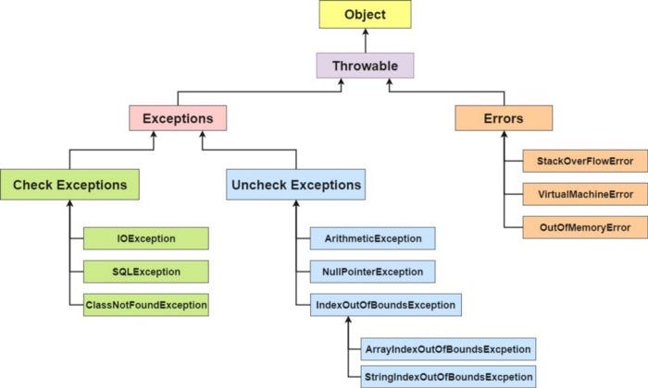
Understanding the hierarchy of exceptions
Understanding the hierarchy of exceptions in Java is crucial for writing robust and error-handling code.
The exception hierarchy in Java is as follows:
Throwable: This is the root class for all exceptions and errors in Java.
It has two main subclasses: Error and Exception.
Error: These are severe problems that should not be caught or handled programmatically. They usually indicate issues that are beyond the control of the programmer and typically result in termination of the application. Examples include OutOfMemoryError and StackOverflowError.
Exception: These are problems that can be caught and handled programmatically. Exceptions can be further categorized into two types: Checked Exceptions and Unchecked Exceptions.

Slide 35
Checked Exceptions
Checked Exceptions
Checked exceptions are exceptions that the compiler forces you to handle explicitly by using try-catch blocks or declaring them with throws in the method signature.
These exceptions are usually recoverable and represent conditions that might occur during the execution of a program but are beyond the program's control.
Examples:
IOException: Thrown when an input or output operation fails, such as reading or writing to a file.
SQLException: Thrown when there is an error in the database interaction.
ClassNotFoundException: Thrown when a class cannot be found during runtime reflection.
FileNotFoundException: A specific type of IOException indicating that a requested file does not exist.
InterruptedException: Thrown when a thread is interrupted while waiting, sleeping, or blocking.

Slide 36
Unchecked Exceptions
Unchecked Exceptions(RuntimeExceptions):
Unchecked exceptions (also known as runtime exceptions) do not need to be explicitly caught or declared in the method signature.
They typically indicate programming errors or violations of contracts that should be fixed during development.
Examples:
NullPointerException: Thrown when attempting to access an object or method on a null reference.
ArrayIndexOutOfBoundsException: Thrown when trying to access an array element with an invalid index.
ArithmeticException: Thrown when an arithmetic operation results in an error, such as division by zero.
IllegalArgumentException: Thrown when an invalid argument is passed to a method.
ClassCastException: Thrown when an attempt is made to cast an object to an incompatible type.

Slide 37
Exception Handling Best Practices
Use Specific Exception Types: Instead of catching generic exceptions, catch specific exception types that you expect might occur. This helps you handle different types of errors differently and provides more accurate error diagnostics.
Avoid Catching Everything: Avoid using catch-all blocks unless absolutely necessary. Catching too many exceptions can hide bugs and make debugging difficult. Only catch exceptions that you can handle properly.
Logging Exceptions: Log exceptions when they occur. This helps in diagnosing issues and understanding the flow of your program during runtime.
Rethrow Exceptions (When Appropriate): If you catch an exception but cannot fully handle it at that point, consider rethrowing it so that it can be caught and properly handled at a higher level.
Graceful Degradation: When possible, design your code to gracefully handle expected exceptions. This can include fallback mechanisms, retry logic, or providing default values.
Use Finally Blocks: Use finally blocks to ensure that cleanup code (such as closing files or releasing resources) is executed regardless of whether an exception occurred or not.
Custom Exception Classes: Create custom exception classes to encapsulate specific error scenarios. This can make your code more readable and provide meaningful information about the error.

Slide 38
Exception hands-on

Slide 39
Interview Questions

Slide 40
Exceptions Interview Questions
What is the difference between checked and unchecked exceptions in Java?
How can you prevent an unchecked exception from causing your program to terminate abruptly?
Explain the purpose of the try-catch block and how it handles exceptions.
What is the role of the finally block in exception handling? Give an example scenario where it is useful.
Can you have multiple catch blocks for a single try block? If yes, how are they executed?
What is the significance of the throws keyword in method signatures?
How does the try-with-resources statement improve resource management in Java?
What is exception chaining, and how does it help in diagnosing errors?
How can you create a custom exception class in Java? Provide an example.

Slide 41
Exceptions Interview Questions
Explain the difference between a checked exception and an unchecked exception with examples.
What is the purpose of the throw statement, and how is it used?
Can a catch block catch multiple exceptions simultaneously? If yes, how?
How would you handle an exception that occurs in a constructor?
Describe the order of execution when an exception is thrown within a nested set of try-catch-finally blocks.
How can you ensure that a resource, such as a file, is closed even if an exception is thrown??
How does Java's exception handling mechanism contribute to code readability and maintainability?
Explain the concept of exception swallowing and why it should be avoided.
Can you throw an exception without catching it? If yes, how would you do it?

Slide 42
Assignments

Slide 43
Exception Assignments
1. Simple Exception Handling
Write a Java program that prompts the user to input two numbers. Perform division on these numbers and handle potential exceptions such as division by zero and invalid input (non-numeric input). Implement appropriate exception handling and provide error messages for each type of exception.
2. Custom Exception
Create a custom exception class named InvalidAgeException. Write a program that takes the age of a person as input and throws this exception if the age is less than 0 or greater than 120. Handle the custom exception using a try-catch block.
3. File Handling and Exceptions
Write a program that reads data from a text file named data.txt. Each line of the file contains an integer. Calculate the sum of all integers in the file. Handle exceptions that may occur during file reading and parsing. Make use of the try-with-resources statement to ensure proper file closure.

Slide 44
Exception Assignments
4. Exception Propagation and Multi-Layered Exception Handling
Create a multi-layered program with multiple methods. One method should read an integer from the user. Another method should divide two numbers provided by the user and return the result. Implement exception handling in each method. If an exception occurs in any method, it should be propagated up the call stack and handled at the appropriate level.
5. Exception Chains
Write a program that reads data from a CSV file containing employee records. Each record has fields for name, age, and salary. Implement exception handling to catch and log any exceptions that may occur while reading or parsing the file. Include exception chaining to provide more context about the error.
6. Nested Exception Handling
Create a program that simulates a simple banking system. Implement classes for BankAccount and Transaction. Write a method that transfers funds between two bank accounts, handling exceptions such as insufficient funds, invalid account numbers, etc. Implement nested exception handling to provide detailed error messages.

Slide 45
Java Packages

Slide 46
Java Packages
What is a Package?
A package in Java is a way to organize related classes, interfaces, and sub-packages into a structured hierarchy.
It provides a mechanism to group logically related classes together, making it easier to manage and maintain a large codebase.
Packages help in preventing naming conflicts, provide access control, and contribute to code modularity.

Slide 47
Java Packages
Benefits of Using Packages in Java:
Modularity and Organization: Packages help in organizing classes into meaningful groups, allowing developers to focus on specific functionality.
Naming Conventions: Packages ensure unique naming, reducing the chance of naming conflicts between classes.
Access Control: By default, classes in the same package have package-level access, and this helps in encapsulating the implementation details.
Code Reusability: You can create reusable components in packages, making it easier to share code across different projects.
Collaboration: Packages facilitate collaboration among developers by providing a clear structure and separation of concerns.
Maintenance: Organized code in packages is easier to maintain, refactor, and debug.
Dependency Management: Packages allow you to manage dependencies efficiently by clearly indicating the relationships between components.

Slide 48
Java Packages
Package Declaration
A package declaration is the first line of a Java source file.
It specifies the package to which the class belongs.
Example:
package com.example.myproject;
Creating Packages in Java
To create a package, you structure your codebase into directories that correspond to the package hierarchy.
For instance, if the package is com.example.myproject, your class files should be stored in com/example/myproject directory.
Importing Packages and Classes:
You can import packages or specific classes from them using the import statement.
This allows you to use classes without specifying their full qualified names every time.
Accessing Classes in Different Packages:
To access classes from different packages, you use the import statement or specify the fully qualified class name (including the package) when using the class.

Slide 49
Java Packages
Default Package and Its Limitations
Classes without a package declaration belong to the "default package."
It is recommended to avoid using the default package due to limitations in code organization, access control, and potential naming conflicts.
Using Import Statements for External Classes
The import statement helps in using classes without typing their full qualified names.
Example:
import java.util.ArrayList;
Package Naming Conventions:
Package names are typically in lowercase letters to avoid naming conflicts with class names.
The convention often follows a reverse domain name structure, like com.example.myproject.

Slide 50
JVM Architecture

Slide 51
Introduction to JVM and Java Architecture
What is JVM?
Role of JVM in Java Programming
Overview of Java Architecture: Compilation and Execution

Slide 52
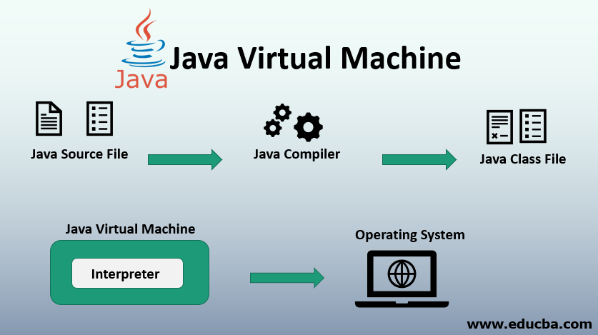
JVM
What is JVM (Java Virtual Machine)?
Java Virtual Machine (JVM) is a fundamental component of the Java Runtime Environment (JRE).
JVM is an abstract machine that provides an execution environment for Java bytecode.
JVM enables Java programs to run on various hardware and operating systems without modification.
JVM acts as an intermediary between compiled Java code (bytecode) and the host system's hardware and operating system.

Slide 53
Role of JVM in Java Programming
The JVM plays a crucial role in the execution of Java programs:
Loading: JVM loads compiled Java bytecode (.class files) from the classpath into memory.
Verification: It ensures that the bytecode is valid and adheres to security constraints.
Execution: JVM interprets or compiles the bytecode into native machine code that can be executed by the host system.
Memory Management: It manages memory allocation and garbage collection, freeing up memory occupied by objects no longer in use.
Execution Engine: JVM contains an execution engine that runs the bytecode, translating it to machine code.
Platform Independence: JVM abstracts the hardware and operating system details, making Java programs platform-independent.
Security: JVM enforces security checks to prevent unauthorized access to system resources.

Slide 54
JVM Components
Class Loader Subsystem
Runtime Data Area: Heap, Stack, Method Area, PC Register, Native Method Stack
JVM Instructions and Execution Engine
Bytecode and Just-In-Time (JIT) Compiler
How JVM executes Java programs

Slide 55
Overview of Java Architecture: Compilation and Execution
Compilation
The Java source code (.java files) is compiled by the Java Compiler (javac) into bytecode (.class files). This bytecode is a platform-independent representation of the source code.
Execution
When a Java program is executed, the JVM loads the bytecode into memory and executes it. There are two approaches to execution:
Interpretation
In this approach, the bytecode is interpreted line by line, executing the corresponding machine code for each bytecode instruction. This approach provides platform independence but can be slower.
Just-In-Time (JIT) Compilation
Some modern JVMs use JIT compilation. They convert bytecode into native machine code just before execution, optimizing performance by leveraging the host system's hardware. This approach balances platform independence with improved execution speed.
In Summary:
JVM Instructions are like special recipes for the JVM to understand your Java code.
The Execution Engine is the part of the JVM that follows these recipes.
The Interpreter reads bytecode step by step, and the JIT Compiler turns frequently used bytecode into fast machine code.
Together, these make sure your Java code gets executed by the computer's hardware in an efficient and accurate way.

Slide 56
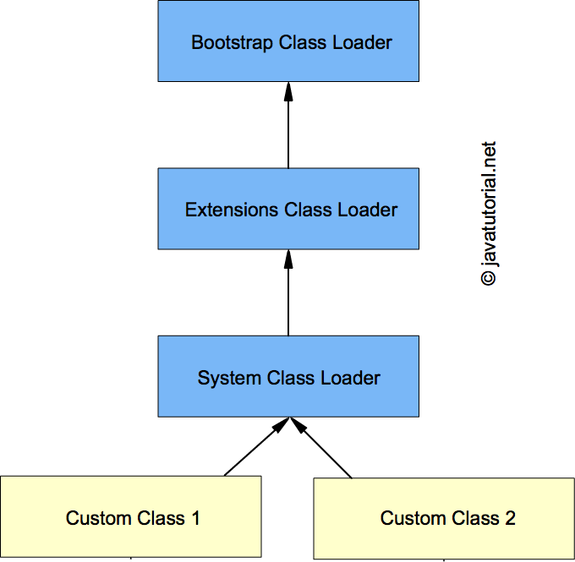






Class Loader Subsystem
The Class Loader subsystem is responsible for loading classes into memory as they are referenced by the program.
It includes three main components:
Bootstrap Class Loader: Loads core Java classes located in the rt.jar file.
Extension Class Loader: Loads classes from the extension directories.
Application Class Loader: Loads classes from the classpath, including user-defined classes.

Slide 57
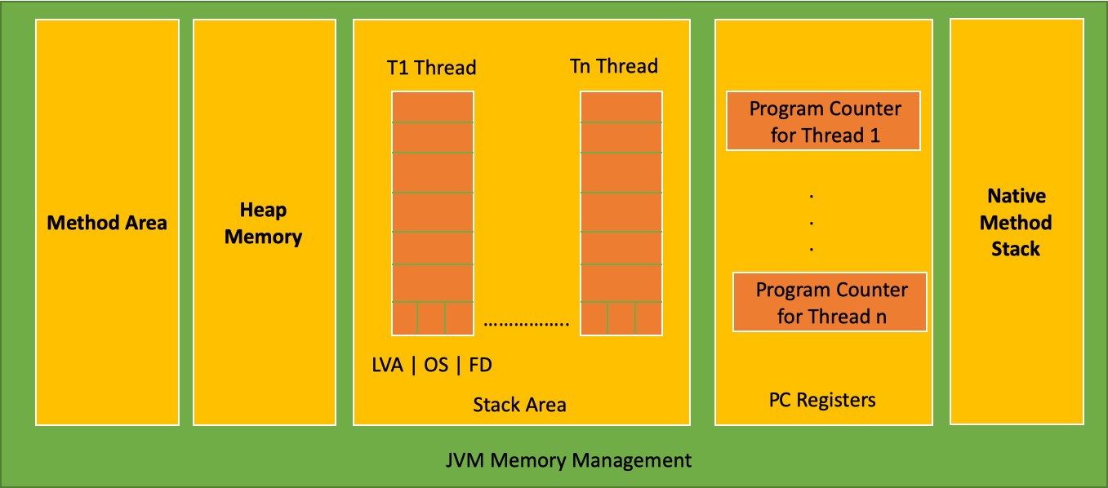
Runtime Data Area: Heap, Stack, Method Area
Heap
The heap is like a big storage area where objects are kept during the program's runtime.
It's where dynamically created objects (like instances of classes) are stored.
The heap is divided into two main parts: Young Generation and Old Generation.
In the Young Generation, there are areas called Eden and Survivor spaces where new objects are created.
Objects that survive multiple rounds of garbage collection in the Young Generation are moved to the Old Generation.
Stack
Imagine a stack of plates. The stack in programming is similar – it keeps track of what a program is doing.
Each time a method is called, a new "plate" is added to the stack (method call frame).
Local variables and function call information are kept on these plates.
When a method finishes, its plate is removed from the stack.

Slide 58
Runtime Data Area: PC Register, Native Method Stack
Method Area
Think of this as a library where the JVM stores information about classes and methods.
It stores class-level data, like method code (instructions), field information, and a constant pool (special values used by methods).
This area is shared among all threads in the program.
PC Register (Program Counter Register)
Imagine you're reading a book and want to remember the page you're on – that's the PC Register.
It keeps track of which instruction the CPU should execute next.
Each thread has its own PC Register.
Native Method Stack
This is like a special area for methods written in other programming languages (not Java).
It's used when Java code calls a method written in a different language.
The data related to these non-Java methods is stored here.

Slide 59
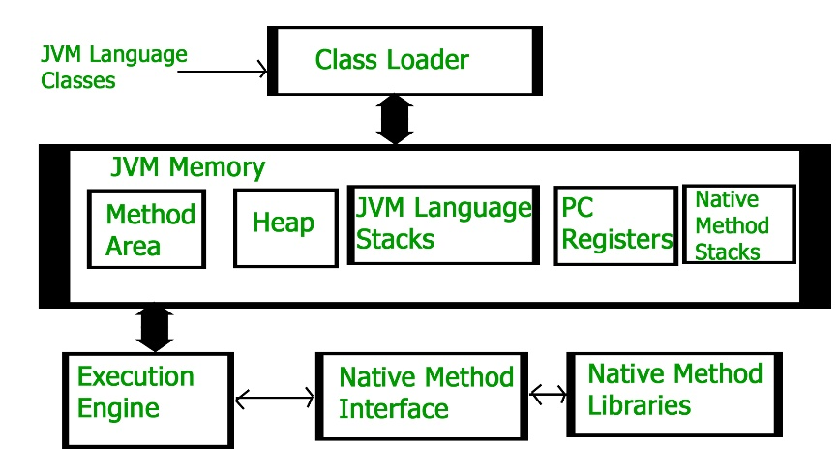
How JVM executes Java programs
Class Loading
The JVM starts by loading the classes that your program uses. These classes are found in the classpath.
The Class Loader subsystem finds and loads the class files into memory. It verifies them to make sure they're safe to use.
Memory Allocation (Heap)
The JVM uses a part of memory called the Heap to store objects created by your program.
When you create objects using new, the JVM sets aside memory for them in the Heap.
The Heap is divided into two parts: Young Generation and Old Generation.
Method Execution
When you call a method in your program, the JVM creates a special area in memory called the stack frame.
The stack frame holds all the information about the method call, like local variables and method parameters.
Each method call gets its own stack frame, like a stack of plates, where each plate holds the information for one method.
Class Loading
The JVM starts by loading the classes that your program uses. These classes are found in the classpath.
The Class Loader subsystem finds and loads the class files into memory. It verifies them to make sure they're safe to use.

Slide 60
How JVM executes Java programs
Memory Allocation (Heap)
The JVM uses a part of memory called the Heap to store objects created by your program.
When you create objects using new, the JVM sets aside memory for them in the Heap.
Method Execution
When you call a method in your program, the JVM creates a special area in memory called the stack frame.
The stack frame holds all the information about the method call, like local variables and method parameters.
Execution Engine
The Execution Engine takes the bytecode (special instructions) generated by the Java Compiler and executes them.
It can do this in two ways:
It can read each bytecode instruction one by one and do what it says (this is called interpreting).
It can turn groups of bytecode instructions into super-fast machine code (using the JIT Compiler), which is then executed directly by the computer's hardware.

Slide 61
How JVM executes Java programs
Garbage Collection
As your program runs, it creates objects in the Heap. Sometimes, objects are not needed anymore, but they still take up memory.
The Garbage Collector looks for objects that are no longer used (unreachable), and it frees up the memory they were using.
This helps keep your program efficient and prevents memory from running out.
Exception Handling
If something unexpected (an exception) happens during program execution, the JVM knows how to handle it.
The JVM looks through the stack frames to find the right place to handle the exception. This is called the "exception handler."
Native Method Invocation
Sometimes, your Java program might use methods written in other programming languages (like C or C++).
The Native Method Stack is used to manage these methods and their data.
Termination
When your program's main method is done running, or if an unhandled exception occurs, the program stops.
The JVM cleans up any remaining memory and resources used by the program.

Slide 62
Java Memory Management

Slide 63
Java Memory Management
Overview of Java Memory Management
Stack vs. Heap Memory
Java Objects and Memory Allocation
Object Creation and Initialization in Heap
Reference Variables and Object Lifetimes

Slide 64
Overview of Java Memory Management
Java memory management involves allocating and managing memory resources for objects and data used by Java programs.
The Java Virtual Machine (JVM) handles memory management, ensuring that memory is efficiently used and objects are properly allocated and reclaimed.
Stack vs. Heap Memory
Stack Memory:
It's like a stack of plates, where each plate represents a method call.
Local variables, method parameters, and method call information are stored here.
The memory is automatically managed, and when a method call finishes, its plate is removed.
Heap Memory:
It's a large storage area where objects are stored.
Objects created using the new keyword are allocated memory here.
The memory needs to be manually managed, and the Java Garbage Collector helps remove objects that are no longer used.

Slide 65
Java Objects and Memory Allocation
Java objects are instances of classes. They have data (fields) and methods associated with them.
Memory is allocated for objects in the heap when they are created using the new keyword.
Object Creation and Initialization in Heap:
When an object is created using new, the JVM allocates memory for the object in the heap.
The memory is used to store the object's data (fields) and a reference to the object's class.
Reference Variables and Object Lifetimes:
A reference variable is like a pointer that points to an object in memory.
Objects exist in the heap until they are no longer reachable.
An object becomes unreachable when there are no reference variables pointing to it. When an object becomes unreachable, the Garbage Collector will eventually reclaim its memory.

Slide 66
Garbage Collection

Slide 67
Garbage Collection Basics
Introduction to Garbage Collection
Purpose and Benefits of Garbage Collection
How Garbage Collection Works
Mark-and-Sweep Algorithm and other Garbage Collection Algorithms
Generational Garbage Collection (Young and Old Generation)

Slide 68
Introduction to Garbage Collection
Garbage Collection is an integral part of the Java Virtual Machine (JVM) responsible for handling memory automatically.
Its primary purpose is to prevent memory leaks and improve memory utilization by reclaiming memory occupied by objects that are no longer needed or accessible.
By automating memory management, Garbage Collection reduces the burden on developers to manually release memory resources.
Purpose and Benefits of Garbage Collection:
Prevent Memory Leaks: Garbage Collection ensures that memory used by unreachable objects is released, preventing memory leaks and allowing resources to be properly managed.
Automatic Memory Management: Developers don't need to manually free memory, reducing programming complexity and human errors.
Enhance Productivity: Focus shifts from memory management to application logic, increasing developer productivity.
Optimized Memory Usage: Garbage Collection optimizes memory usage by removing unused objects, making efficient use of available memory.

Slide 69
How Garbage Collection Works
Identifying Unreachable Objects: The Garbage Collector identifies objects that are no longer reachable from any reference variable in the program.
Mark-and-Sweep Algorithm:
This algorithm involves two phases: marking and sweeping.
During marking, the Garbage Collector traverses through all reachable objects, marking them as "alive."
In the sweeping phase, the collector scans the memory and reclaims memory occupied by unmarked (dead) objects.
Generational Garbage Collection (Young and Old Generation):
This approach divides objects into different generations based on their age and usage patterns.
The heap is typically divided into two main parts: Young Generation (where new objects are created) and Old Generation (where long-lived objects reside).

Slide 70
Generational Garbage Collection
Young Generation:
New objects are created in the Young Generation.
A portion of the Young Generation is used as an Eden space.
Objects that survive a garbage collection in the Young Generation are moved to Survivor spaces (usually two).
After several rounds of survival, objects are promoted to the Old Generation.
Old Generation:
The Old Generation contains long-lived objects that survived multiple collections in the Young Generation.
Since objects in the Old Generation are less likely to become unreachable, garbage collection in this generation is less frequent.

Slide 71
Garbage Collection Algorithms
Mark-and-Sweep Algorithm
Simple two-phase process: marking live objects and sweeping memory for dead objects.
Reclaims memory occupied by unreachable objects.
May lead to memory fragmentation.
Copying Algorithm (Young Generation)
Divides memory into two equal parts: one for object allocation and one for copying live objects.
Surviving objects are moved to the other space.
Efficient for collecting short-lived objects, prevents fragmentation.
Mark-Compact Algorithm
Mark-and-Sweep with compaction: moves live objects together to reduce fragmentation.
Objects are marked, then memory is compacted to reclaim space.
Effective for long-lived objects, minimizes fragmentation.

Slide 72
Garbage Collection Algorithms
Generational Garbage Collection
Divides objects by age and usage patterns.
Young Generation for new objects, frequent collection.
Old Generation for long-lived objects, less frequent collection.
Concurrent Mark-Sweep (CMS) Algorithm
Concurrent marking and sweeping to reduce pause times.
Identifies live objects while allowing application execution.
Complex due to concurrent nature.
G1 (Garbage First) Algorithm
Divides heap into regions, collects with minimized pause times.
Adapts collection strategy based on heap state.
Balances pause times and memory utilization.

Slide 73
Interview Questions

Slide 74
Package Interview Questions
What is a package in Java and what purpose does it serve?
How do packages help in organizing classes in Java?
What is the purpose of a package declaration at the beginning of a Java source file?
How are naming conflicts avoided using packages in Java? How can you create a package in Java?
What is the default package in Java, and why is it discouraged to use?
How can you access a class from a different package in Java?
What is the difference between importing a specific class and importing an entire package?
How does the concept of packages contribute to encapsulation and access control in Java?
What is the role of access modifiers (public, protected, private, default) in packages?

Slide 75
Package Interview Questions
What is a fully qualified class name, and when is it used?
Can classes in the same package have package-private access to each other's members?
What is the purpose of the import statement in Java?
How does the JVM locate classes within packages during compilation and execution?
Explain the concept of hierarchical organization of packages in Java.
How can you organize sub-packages within a larger package? What is the difference between the classpath and the package name in Java?
Can multiple classes have the same name if they belong to different packages?
What are some best practices for naming packages and classes in Java?

Slide 76
JVM Architecture Interview Questions
What is the Java Virtual Machine (JVM), and what role does it play in Java programming?
Explain the concept of "Write Once, Run Anywhere" in the context of JVM.
What are the main components of the JVM architecture?
Describe the process of compiling and executing a Java program using the JVM.
What is the purpose of the Class Loader subsystem in the JVM?
Explain the roles of the Bootstrap Class Loader, Extension Class Loader, and Application Class Loader.
How does the JVM handle memory management during program execution? What are the memory areas in the JVM?
What is the purpose of the Method Area (Permanent Generation) in the JVM's memory structure?
Describe the function of the Java Stack and its relation to method calls in the JVM.
What is the Native Method Stack, and how does it differ from the Java Stack?
How does the JVM manage the execution of Java bytecode? What are the roles of the Interpreter and JIT Compiler?

Slide 77
JVM Architecture Interview Questions
What is the significance of the PC Register (Program Counter) in the JVM?
How does the JVM handle exceptions during program execution?
What is the purpose of the Classpath in the JVM's execution environment?
Explain the significance of the "java" command when launching a Java program.
How does the JVM handle multithreading and synchronization?
Describe the significance of the "native" keyword in Java and how the JVM interacts with native methods.
What is the role of the Security Manager in the JVM's security architecture?
How does Just-In-Time (JIT) compilation improve the performance of Java programs?
Explain the concept of "HotSpot" in the context of JVM optimization.
Describe the JVM's ability to dynamically load and link classes during program execution.
How does the JVM ensure platform independence while executing Java programs?

Slide 78
Garbage Collection Interview Questions
What is garbage collection in Java, and why is it important?
How does garbage collection contribute to memory management in Java?
Describe the process of identifying and reclaiming memory occupied by unreachable objects.
What is the difference between the Young Generation and the Old Generation in garbage collection?
Explain the concept of Generational Garbage Collection and how it works.
How does the Mark-and-Sweep algorithm work for garbage collection?
What is memory fragmentation, and how do garbage collection algorithms address it?
How does the Copying Algorithm optimize memory usage in the Young Generation?
What is the purpose of the Mark-Compact algorithm in garbage collection?
Explain the advantages of using the Concurrent Mark-Sweep (CMS) algorithm.

Slide 79
Garbage Collection Interview Questions
How does the G1 (Garbage First) garbage collection algorithm optimize memory management?
How does garbage collection interact with objects that have different lifetimes?
What are the trade-offs between pause times and efficiency in garbage collection algorithms?
What are the challenges of managing memory in long-lived objects during garbage collection?
Explain how garbage collection contributes to the "Stop-the-World" phenomenon and its implications.
What strategies can developers employ to optimize memory usage and minimize the impact of garbage collection?
How does understanding the principles of garbage collection impact the design of Java applications?
Describe scenarios where using specific garbage collection algorithms would be advantageous.
What are some common memory-related issues that developers might encounter in Java applications?
How can monitoring and tuning garbage collection settings improve application performance?

Slide 80
Assignments

Slide 81
Assignments
Assignment 1: Creating Packages and Importing Classes
Create a package named "com.myapp.util".
Inside the package, create a class named "MathUtils" with methods to calculate addition, subtraction, multiplication, and division.
In a separate class, import and use the "MathUtils" class to perform mathematical operations.
Assignment 2: Organizing Code Using Packages
Create a package structure for a simple address book application.
Inside the package, create classes for "Person" and "Address" with relevant attributes and methods.
Use these classes in a main class to simulate adding and searching for people in the address book.
Assignment 5: Package Naming Conventions and Best Practices
Choose a domain name in reverse order, like "com.example.myapp".
Create a package structure for a small e-commerce application with categories such as "product", "order", and "user".
Inside each package, create relevant classes following naming conventions.

Slide 82
Q&A

